Slide 1
N-T-Fit-semi_FEA.py
Purpose: Fitting to n–T Hall data
非縮退半導体のHall移動度・キャリア密度にフィッティング
Model: Free electron model, single donor and acceptor
Consider coexistence of electrons and holes
Functions:
(i) mode = ‘sim’: Plot n–T data in linear,
and Arrhenius plots of log(n) – 1/T, log(nT ^{–3/2}) – 1/T, and and log(nT ^{–3/4}) – 1/T
Plot E_{a}–T from these Arrhenius slopes
(iii) mode = ‘fit’: Non-linear least-squares fitting by two-carrier model
’fit_h’, ‘fit_e’: Non-linear least-squares fitting by single-carrier model
Theory: Attached in this file after usage of the program

Slide 2
N-T-Fit-semi_FEA.py
Program: [data-COE]\electrical\N-T-Fit-semi_FEA.py
[Programs]\python\electrical\ N-T-Fit-semi_FEA.py
Data: [data-COE]\electrical\Hall-T
Usage:
python ..\N-T-Fit-semi_FEA.py mode (file args)
(i) python ..\N-T-Fit-semi_FEA.py sim infile(.xlsx) EC EA NA ED ND
Plot N-T with simulated data
ex: python ..\N-T-Fit-semi_FEA.py sim None 1.1 0.05 0.0 1.05 8e+16
(ii) python ..\N-T-Fit-semi_FEA.py fit|fit_h|fit_e infile(.xlsx) EC EA NA ED ND Eb a1 a2)
Fit to N-mu-T data
mode = fit : Fit to Ns = 1/eRH by two-carrier (hole-electron) model
fit_h: Fit to Nh by single-carrier model
fit_e: Fit to Ne by single-carrier model
ex: python ..\N-T-Fit-semi_FEA.py fit None 1.1 0.05 0.0 1.05 8e+16
Input file: Hall data, Excel (*.xlsx)
Output file: Parameter file (.in)
CSV files

Slide 3
Data file (.xlsx / .csv)
[data-COE]\electrical\Hall-T\Hall-SnSe.xlsx
The order of the data columns are arbitrary.
The data types are judged by the key words in the first line labels.
Temperature in K : Label must start from capital ‘T’ followed by [ |(|[]
Conductivity in S/cm : Label must start from ‘sigma’
Carrier density in cm⁻³ : Label must start from ‘n’
For RH < 0, n should be negative
Mobility in cm²/(Vs) : Label must start from ‘mu’
RH is not necessary but better to provide
T (K) | n (cm-3) | RH (cm3/C) | mu(cm2/Vs) | sigma(S/cm)
249.8715 | 1.02E+14 | 61321.72 | 3.76297 | 6.14E-05
274.44749 | 3.66E+14 | 17055.4 | 4.06679 | 2.38E-04
297 | 1.00E+15 | 6241.509 | 4 | 6.41E-04
325 | 2.00E+15 | 3120.755 | 5 | 1.60E-03
370 | 8.00E+15 | 780.1886 | 5.5 | 7.05E-03
428 | 3.00E+16 | 208.0503 | 5.3 | 2.55E-02
472 | 8.50E+16 | 73.42952 | 4.7 | 6.40E-02
523 | 1.80E+17 | 34.67505 | 4.8 | 1.38E-01
572 | 4.00E+17 | 15.60377 | 4.3 | 2.76E-01
625 | 9.00E+17 | 6.93501 | 3.6 | 5.19E-01
672 | 2.80E+18 | 2.22911 | 2.7 | 1.21E+00

Slide 4
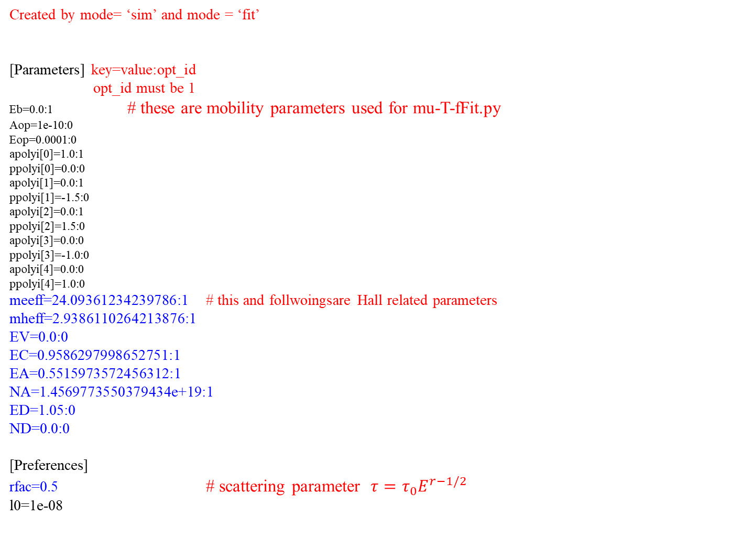
Parameter file (.in)
Created by mode= ‘sim’ and mode = ‘fit’
[Parameters] key=value:opt_id
opt_id must be 1
Eb=0.0:1 # these are mobility parameters used for mu-T-fFit.py
Aop=1e-10:0
Eop=0.0001:0
apolyi[0]=1.0:1
ppolyi[0]=0.0:0
apolyi[1]=0.0:1
ppolyi[1]=-1.5:0
apolyi[2]=0.0:1
ppolyi[2]=1.5:0
apolyi[3]=0.0:0
ppolyi[3]=-1.0:0
apolyi[4]=0.0:0
ppolyi[4]=1.0:0
meeff=24.09361234239786:1 # this and follwoingsare Hall related parameters
mheff=2.9386110264213876:1
EV=0.0:0
EC=0.9586297998652751:1
EA=0.5515973572456312:1
NA=1.4569773550379434e+19:1
ED=1.05:0
ND=0.0:0
[Preferences]
rfac=0.5 # scattering parameter $τ=τ_{0}E^{r−1/2}$
l0=1e-08

Slide 5
0th step:
Delete parameter file for reset
N-T-Fit-semi_FEA.py reads parameters from
the parameter file (.in) if it exists.
If you restart from scratch, delete it.
C:> del Hall-Ca0.0Sn1.0Se.in
(change the file name)

Slide 6
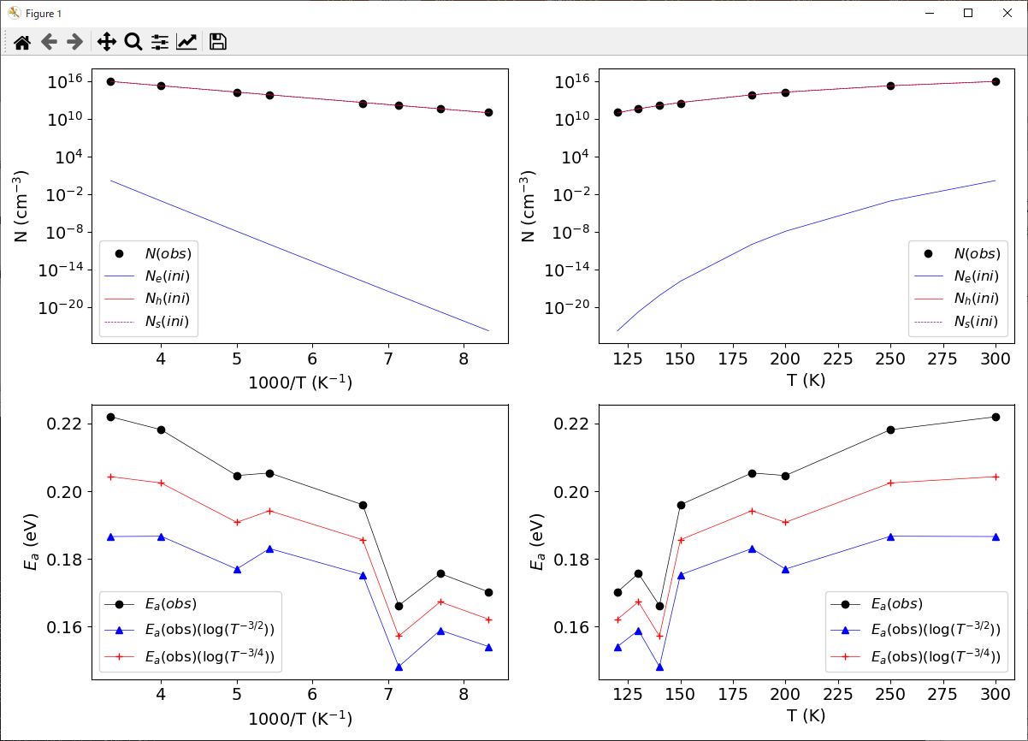
1st step:
Check possible parameters and create parameter file
python ..\N-T-Fit-semi_FEA.py sim Hall-Ca0.0Sn1.0Se.xlsx
Console output:
Calculate n-T from the initial parameters
T 1000/T EF(eV) Ne,obs(cm-3) Ne,ini Nh,ini NA-,ini ND+,ini RH,ini Ns,ini
300.0000 3.3333 0.5733 1.047e+16 5.81433e+09 5.81431e+09 0 0 -1047.83
250.0000 4.0000 0.5695 1.88e+15 6.27783e+07 6.2778e+07 0 0 -126856
200.0000 5.0000 0.5656 1.54e+14 75956.8 75956.3 0 0 -1.41791e+08
-- cut --
Activation energy
T(K) Ea(eV)(log(N)) Ea(eV)(log(N*T^-1.5))
300 0.221971 0.18662
250 0.218156 0.186709
200 0.204629 0.177014
184 0.205381 0.183069
150 0.196006 0.175324
140 0.166232 0.148197
130 0.175696 0.158959
120 0.170266 0.154126
Estimate E_{D}/E_{A} from
E_{a} in the impurity region

Slide 7
2nd step: Check and edit parameter file (.in)
Hall-Ca0.0Sn1.0Se.in
[Parameters] # Variable name=Value:Optimize ID
meeff=0.3:1 # Electron effective mass to calculate N_{C} [m_{e}]
mheff=1.0:1 # Hole effective mass to calculate N_{V} [m_{e}]
EV=0.0:0 # Valence band energy. Usuall fixed to 0 [eV]
EC=1.1:0 # Conduction band energy. Equal to E_{g} if E_{V} = 0 [eV]
EA=0.05:1 # Acceptor level [eV]
NA=0.0:1 # Acceptor density [cm⁻³]
ED=1.05:0 # Donor level [eV]
ND=0.00 # Donor density [cm⁻³]
Fix parameters by chaing optimized IDs to
Change to variable parameters by changing optimized IDs to 1
Change ED and EA to the values estimated at the 1st step
Run mode = ‘sim’ (1st step) and find good initial parameters
[Parameters]
meeff=10.0:1
mheff=14.0:1
EV=0.0:0
EC=1.0:0
EA=0.4:1
NA=1e+18:1
ED=1.05:0
ND=0.0:0

Slide 8
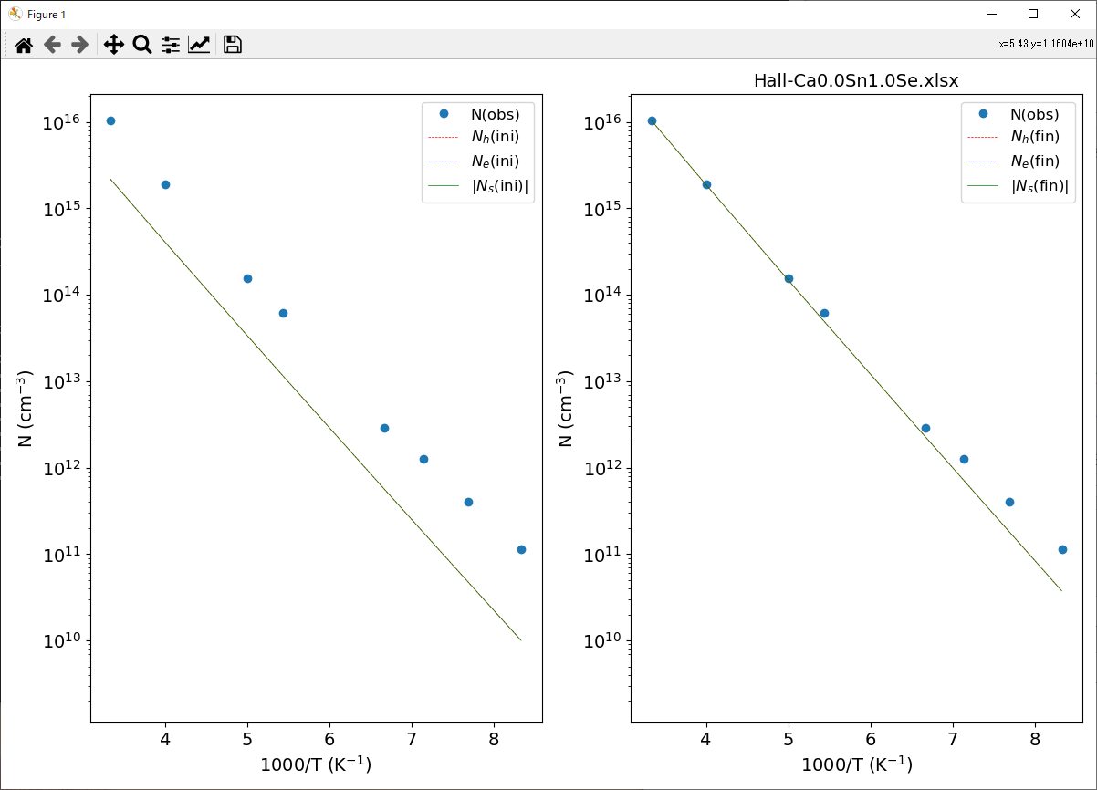
3rd step: Non-linear LSQ
python ..\N-T-Fit-semi_FEA.py fit Hall-Ca0.0Sn1.0Se.xlsx
Console output
Warning: Maximum number of iterations has been exceeded.
Optimized at S2= 2.71452e+25:
meeff : 2.0068064 me : optid=1
mheff : 5.3342763 me : optid=1
EV : 0 eV : optid=0
EC : 1 eV : optid=0
EA : 0.40872453 eV : optid=1
NA : 2.6364306e+18 cm-3 : optid=1
ED : 1.05 eV : optid=0
ND : 0 cm-3 : optid=0
NV : 3.091617050410829e+20 me at 300 K
DV0: 8.39265315408184e+22 me at 300 K
NC : 7.133959751624516e+19 me at 300 K
DC0: 1.9366192136444656e+22 me at 300 K
If ‘Warning: Maximum number of iterations has been exceeded’ appears, run mode = ‘fit‘ again.

Slide 9
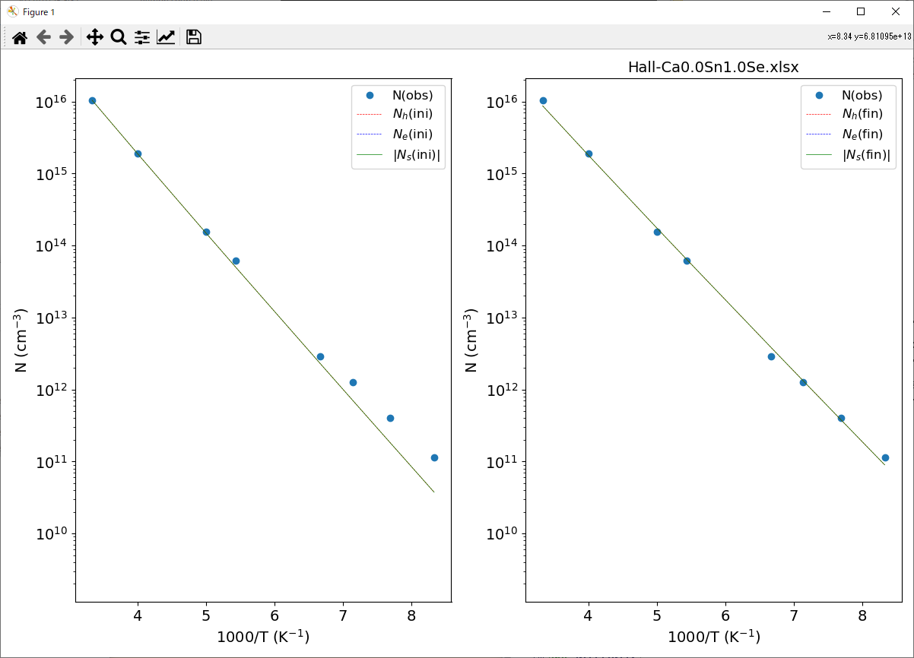
3’rd step: Non-linear LSQ
python ..\N-T-Fit-semi_FEA.py fit Hall-Ca0.0Sn1.0Se.xlsx
Console output
Optimized at S2= 0.0280408:
meeff : 5.6543738 me : optid=1
mheff : 1.7872351 me : optid=1
EV : 0 eV : optid=0
EC : 1 eV : optid=0
EA : 0.37233232 eV : optid=1
NA : 2.3221107e+18 cm-3 : optid=1
ED : 1.05 eV : optid=0
ND : 0 cm-3 : optid=0
NV : 5.99577017210199e+19 me at 300 K
DV0: 1.6276407661600518e+22 me at 300 K
NC : 3.3740321229465105e+20 me at 300 K
DC0: 9.159310767437249e+22 me at 300 K

Slide 10
Theory

Slide 11
半導体の電子構造
  $E\left(k\right)\sim E_{0}+\frac{ℏ^{2}}{2m^{∗}}k^{2}$
  E に関する状態密度
  $D\left(E\right)=N(E)/V$
  $=\frac{2{π\left(2m^{∗}\right)}^{3/2}}{h^{3}}\sqrt{E}$ (9.41)
Fermi-Dirac分布関数
  $f(E)=\frac{1}{exp(β\left(E−E_{F}\right))+1}$ (8.5)
半導体中:
原子核の総電荷 $Z=\sum{Z_{i}}$ と
総電子数 $N_{e}$
が等しく、電荷中性条件を満たす
・ 電子数の条件 (電荷中性条件)
  $N_{e}=\int{D\left(E\right)f(E)dE}$
・ 真性半導体では、0 Kでは
価電子帯上端 E_{V} まで
電子が詰まっている
エネルギー E
真空準位 E_{vac}
伝導帯
伝導帯下端 E_{C}
E_{C}
バンドギャップ
E_{g}
フェルミ準位 E_{F}
E_{F}
E_{V}
価電子帯上端 E_{V}
価電子帯
状態密度 D(E)

Slide 12
電子と正孔: 電荷中性条件の書き換え
  0 K における全電子数の条件 $N_{e}=\int_{−∞}^{∞_{}}{f\left(E\right)D\left(E\right)dE}=\int_{−∞}^{E_{V}}{D_{h}\left(E\right)dE}$
有限温度における全電子数の条件 => 電荷中性条件に置き換える
$N_{e}=\int_{−∞}^{∞_{}}{f\left(E\right)D\left(E\right)dE}$
$N_{e}$ は $N_{A}$ 程度の大きな数なので、扱いにくい
  => $N_{e}^{′}=\int_{−∞}^{∞}{f(E)D\left(E\right)dE}−N_{e}=0$ を基準に考える
  $N_{e}^{′}=\int_{−∞}^{E_{V}}{f(E)D_{h}\left(E\right)dE}−\int_{−∞}^{E_{V}}{D_{h}\left(E\right)dE}+\int_{E_{C}}^{∞}{f\left(E\right)D_{e}\left(E\right)dE}=−n_{h}+n_{e}=0$
  $n_{h}=\int_{−∞}^{E_{V}}{\left(1−f(E)\right)D_{h}\left(E\right)dE}=\int_{−∞}^{E_{V}}{f_{h}(E)D_{h}\left(E\right)dE}$
  $f_{h}\left(E\right)=1−f\left(E\right)=\frac{\exp\left(β\left(E−E_{F}\right)\right)}{\exp\left(β\left(E−E_{F}\right)\right)+1}=\frac{1}{\exp{(β\left(E_{F}−E\right))}+1}$
※ 正孔は電子が空いた “孔” とみなすことができる
  $n_{e}=\int_{E_{C}}^{∞}{f_{e}(E)D_{e}\left(E\right)dE}$
  $f_{e}(E)=\frac{1}{\exp{(β\left(E−E_{F}\right))}+1}$
  $N_{e}^{′}=−n_{h}+n_{e}=0$ => $n_{h}=n_{e}$: 電荷中性条件
f_{e}(E)
f_{h}(E)
E / eV

Slide 13
自由電子密度、自由正孔密度
E_{F}
  $n_{e}=\int_{E_{C}}^{∞}{f_{e}(E)D_{e}\left(E\right)dE}$
  $f_{e}(E)=\frac{1}{exp(β\left(E−E_{F}\right))+1}$
  $D_{e}\left(E\right)=D_{C0}\sqrt{E−E_{C}}$ (9.41)
  $D_{C0}=\frac{\sqrt{2}}{π^{2}}\frac{{{m_{e}}^{∗}}^{3/2}}{ℏ^{3}}$
  非縮退半導体 $β\left(E−E_{F}\right)$ >>1 では
  $n_{e}\sim \int_{E_{C}}^{∞}{\frac{\sqrt{2}}{π^{2}}\frac{{m_{e}}^{∗3/2}}{ℏ^{3}}\sqrt{E−E_{C}}exp(−β\left(E−E_{F}\right))dE}$
  $=\frac{\sqrt{2}}{π^{2}}\frac{{m_{e}}^{∗3/2}}{ℏ^{3}}e^{−β\left(E_{C}−E_{F}\right)}\int_{0}^{∞}{\sqrt{e}exp(−βe)de}$
  $n_{e}=N_{C}exp(−β\left(E_{C}−E_{F}\right))$
  $N_{C}=2{\left(\frac{{2πm_{e}}^{∗}k_{B}T}{h^{2}}\right)}^{3/2}$ 伝導帯有効状態密度
  同様に
  $n_{h}=N_{V}exp(−β\left(E_{F}−E_{V}\right))$
  $N_{V}=2{\left(\frac{{2πm_{h}}^{∗}k_{B}T}{h^{2}}\right)}^{3/2}$ 価電子帯有効状態密度
f_{e}(E)
D_{V}(E)
状態密度
D_{C}(E)
価電子帯
伝導帯
E_{V}
E_{C}
E
1
f(E)
DOS (cm⁻³/eV)
E_{F} = 0.3 eV
E (eV)

Slide 14
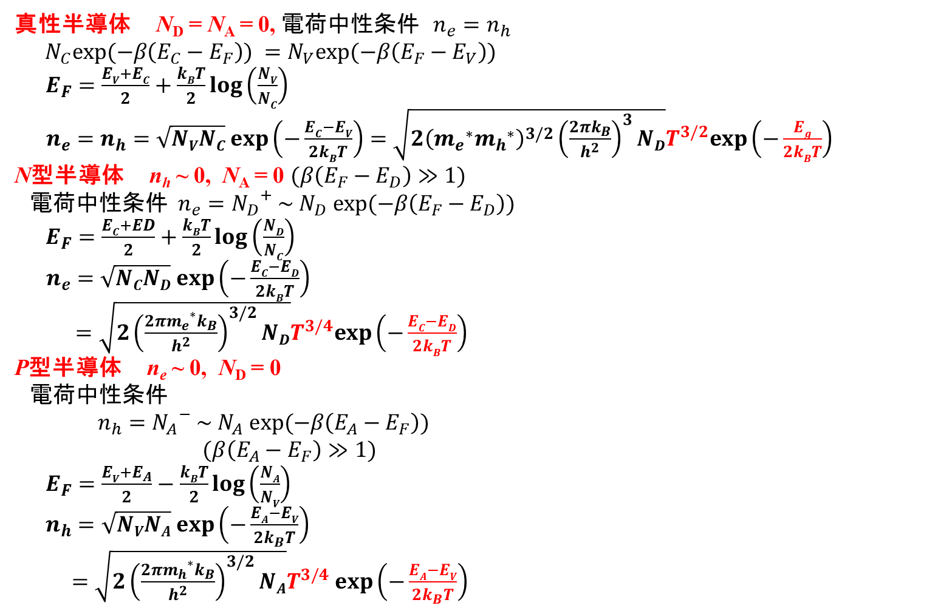
Fermiエネルギーの温度依存性
  真性半導体 N_{D} = N_{A} = 0, 電荷中性条件 $n_{e}=n_{h}$
  $N_{C}exp(−β\left(E_{C}−E_{F}\right)) =N_{V}exp(−β\left(E_{F}−E_{V}\right))$
  $E_{F}=\frac{EV+EC}{2}+\frac{kBT}{2}log\left(\frac{NV}{NC}\right)$
  $n_{e}=n_{h}=\sqrt{NVNC} exp\left(−\frac{EC−EV}{2kBT}\right)=\sqrt{2{\left({m_{e}}^{∗}{m_{h}}^{∗}\right)}^{3/2}{\left(\frac{2πk_{B}}{h^{2}}\right)}^{3}ND}T^{3/2}exp\left(−\frac{Eg}{2kBT}\right)$
  N型半導体 n_{h} ~ 0, N_{A} = 0 $(β\left(E_{F}−E_{D}\right)≫1)$
  電荷中性条件 $n_{e}={N_{D}}^{+} \sim N_{D} exp(−β\left(E_{F}−E_{D}\right))$
  $E_{F}=\frac{EC+ED}{2}+\frac{kBT}{2}log\left(\frac{ND}{NC}\right)$
  $n_{e}=\sqrt{NCND} exp\left(−\frac{EC−ED}{2kBT}\right)$
  $=\sqrt{2{\left(\frac{{2πm_{e}}^{∗}k_{B}}{h^{2}}\right)}^{3/2}ND}T^{3/4}exp\left(−\frac{EC−ED}{2kBT}\right)$
  P型半導体 n_{e} ~ 0, N_{D} = 0
  電荷中性条件
  $n_{h}={N_{A}}^{−} \sim N_{A} exp(−β\left(E_{A}−E_{F}\right))$
  $(β\left(E_{A}−E_{F}\right)≫1)$
  $E_{F}=\frac{EV+E_{A}}{2}−\frac{kBT}{2}log\left(\frac{NA}{NV}\right)$
  $n_{h}=\sqrt{NVNA} exp\left(−\frac{EA−EV}{2k_{B}T}\right)$
  $=\sqrt{2{\left(\frac{{2πm_{h}}^{∗}k_{B}}{h^{2}}\right)}^{3/2}NA}T^{3/4} exp\left(−\frac{EA−EV}{2k_{B}T}\right)$

Slide 15
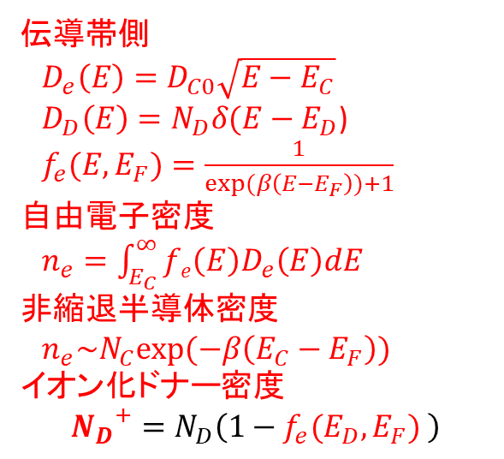
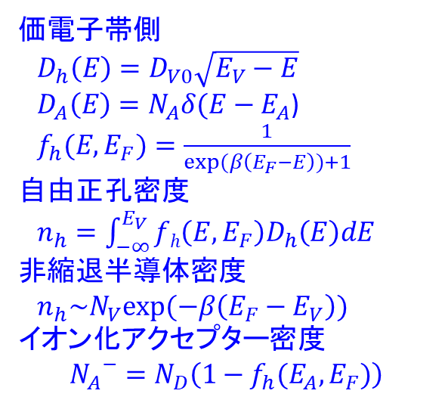
半導体の状態密度、電子、正孔
全状態密度：$D\left(E\right)=D_{e}\left(E\right)+D_{h}\left(E\right)+D_{D}\left(E\right)+D_{A}\left(E\right)$
E_{F}
状態密度
N_{A}
N_{D}
E_{V}
E_{A}
E_{D}
E_{C}
エネルギー
  価電子帯側
  $D_{h}\left(E\right)=D_{V0}\sqrt{E_{V}−E}$
  $D_{A}\left(E\right)=N_{A}δ({E−E}_{A}$)
  $f_{h}(E,E_{F})=\frac{1}{exp(β\left(E_{F}−E\right))+1}$
  自由正孔密度
  $n_{h}=\int_{−∞}^{E_{V}}{fh\left(E,E_{F}\right)D_{h}\left(E\right)dE}$
  非縮退半導体密度
  $n_{h}\sim N_{V}exp(−β\left(E_{F}−E_{V}\right))イオン化アクセプター$密度
  $${N_{A}}^{−}=N_{D}\left(1−f_{h}(E_{A},E_{F})\right)$$
  伝導帯側
  $D_{e}\left(E\right)=D_{C0}\sqrt{E−E_{C}}$
  $D_{D}\left(E\right)=N_{D}δ({E−E}_{D}$)
  $f_{e}(E,E_{F})=\frac{1}{exp(β\left(E−E_{F}\right))+1}$
  自由電子密度
  $n_{e}=\int_{E_{C}}^{∞}{fe\left(E\right)D_{e}\left(E\right)dE}$
  非縮退半導体密度
  $n_{e}\sim N_{C}exp(−β\left(E_{C}−E_{F}\right))イオン化ドナー$密度
  $${N_{D}}^{+}=N_{D}\left(1−f_{e}(E_{D},E_{F}) \right)$$

Slide 16
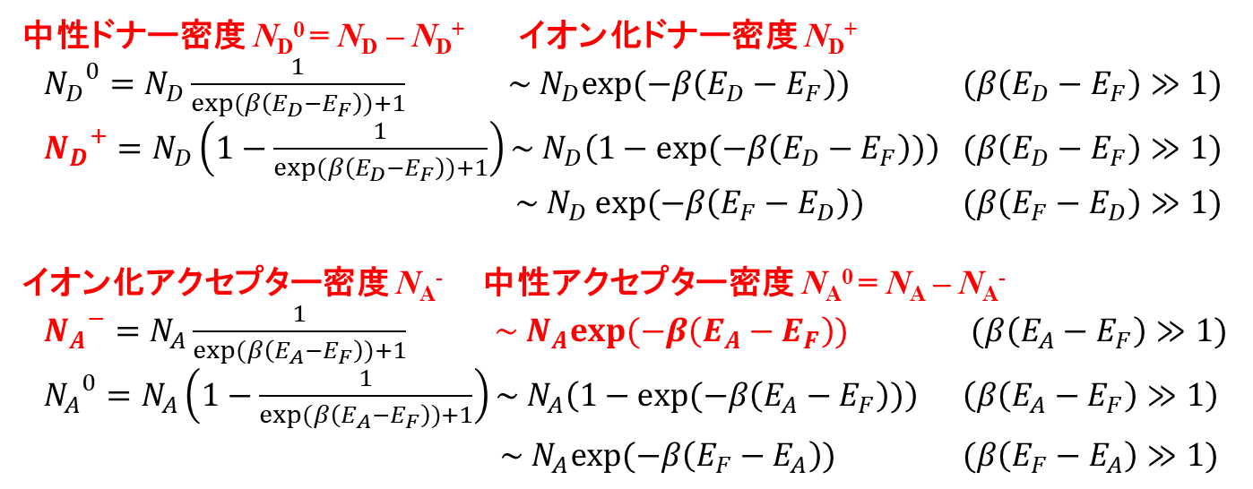
ドナー準位、アクセプター準位の状態: 近似式
E_{F}
状態密度
N_{A}
N_{D}
E_{V}
E_{A}
E_{D}
E_{C}
エネルギー
中性ドナー密度 N_{D}⁰ = N_{D} – N_{D}⁺ イオン化ドナー密度 N_{D}⁺
${N_{D}}^{0}=N_{D}\frac{1}{exp(β\left(E_{D}−E_{F}\right))+1} \sim N_{D}exp(−β\left(E_{D}−E_{F}\right))$ $(β\left(E_{D}−E_{F}\right)≫1)$
${N_{D}}^{+}=N_{D}\left(1−\frac{1}{exp(β\left(E_{D}−E_{F}\right))+1}\right)\sim N_{D}\left(1−exp(−β\left(E_{D}−E_{F}\right))\right)$ $(β\left(E_{D}−E_{F}\right)≫1)$
$\sim N_{D}$ $exp(−β\left(E_{F}−E_{D}\right))$ $(β\left(E_{F}−E_{D}\right)≫1)$
イオン化アクセプター密度 N_{A}⁻ 中性アクセプター密度 N_{A}⁰ = N_{A} – N_{A}⁻
${N_{A}}^{−}=N_{A}\frac{1}{exp(β\left(E_{A}−E_{F}\right))+1} \sim N_{A}exp(−β\left(E_{A}−E_{F}\right))$ $(β\left(E_{A}−E_{F}\right)≫1)$
${N_{A}}^{0}=N_{A}\left(1−\frac{1}{exp(β\left(E_{A}−E_{F}\right))+1}\right)\sim N_{A}\left(1−exp(−β\left(E_{A}−E_{F}\right))\right)$ $\left(β\left(E_{A}−E_{F}\right)≫1\right)$
$\sim N_{A}exp(−β\left(E_{F}−E_{A}\right))$ $(β\left(E_{F}−E_{A}\right)≫1)$

Slide 17
Fermi準位の求め方: 図解
ΔQ = (n_{e} + N_{A}⁻) – (n_{h} + N_{D}⁺) をE_{F}に対してプロットし、ゼロ点を求める
T = 300.0
E_{g} = 1.12
N_{C} = 1.0e19
N_{V} = 1.0e21
N_{D} = 3.0e17
E_{D} = 1.02
N_{A} = 1.0e13
E_{A} = 0.1
E_{F} = 0.997 eV
ΔQ
E_{F}
Log |ΔQ|
E_{F}

Slide 18
Fermi準位の計算: プログラム
ΔQ(E_{F}) = (n_{e} + N_{A}⁻) – (n_{h} + N_{D}⁺) = 0 を満たす E_{F} を求める。
Newton法は発散しやすい ＝＞ 二分法を使う
数値積分の講義資料: http://conf.msl.titech.ac.jp/Lecture/python/index-numericalanalysis.html
原理: f(x) が単調関数であれば、解 x は f(x₀) < 0 かつ f(x₁) > 0
(あるいは f(x₀) > 0 かつ f(x₁) < 0) を満たす区間 [x₀, x₁] に1つ存在する。
手順: f(x₀) < 0 かつ f(x₁) > 0の場合を考える (f(x₀)･f(x₁) < 0 で判断)。
x₂ = (x₀ + x₁) / 2.0
f(x₂) > 0 (f(x₀)･f(x₂) < 0) であれば、 x₁ をx₂ で置き換える
f(x₂) < 0 (f(x₁)･f(x₂) < 0) であれば、 x₀ をx₂ で置き換える
|x₁ – x₀|, |f(x₁) – f(x₀)| が必要な精度以下になったら、
解を x₂ にして反復終了
1. に戻って反復
x₄
x₅
x₀
x₃
x₂
x₁
x₆

Slide 19
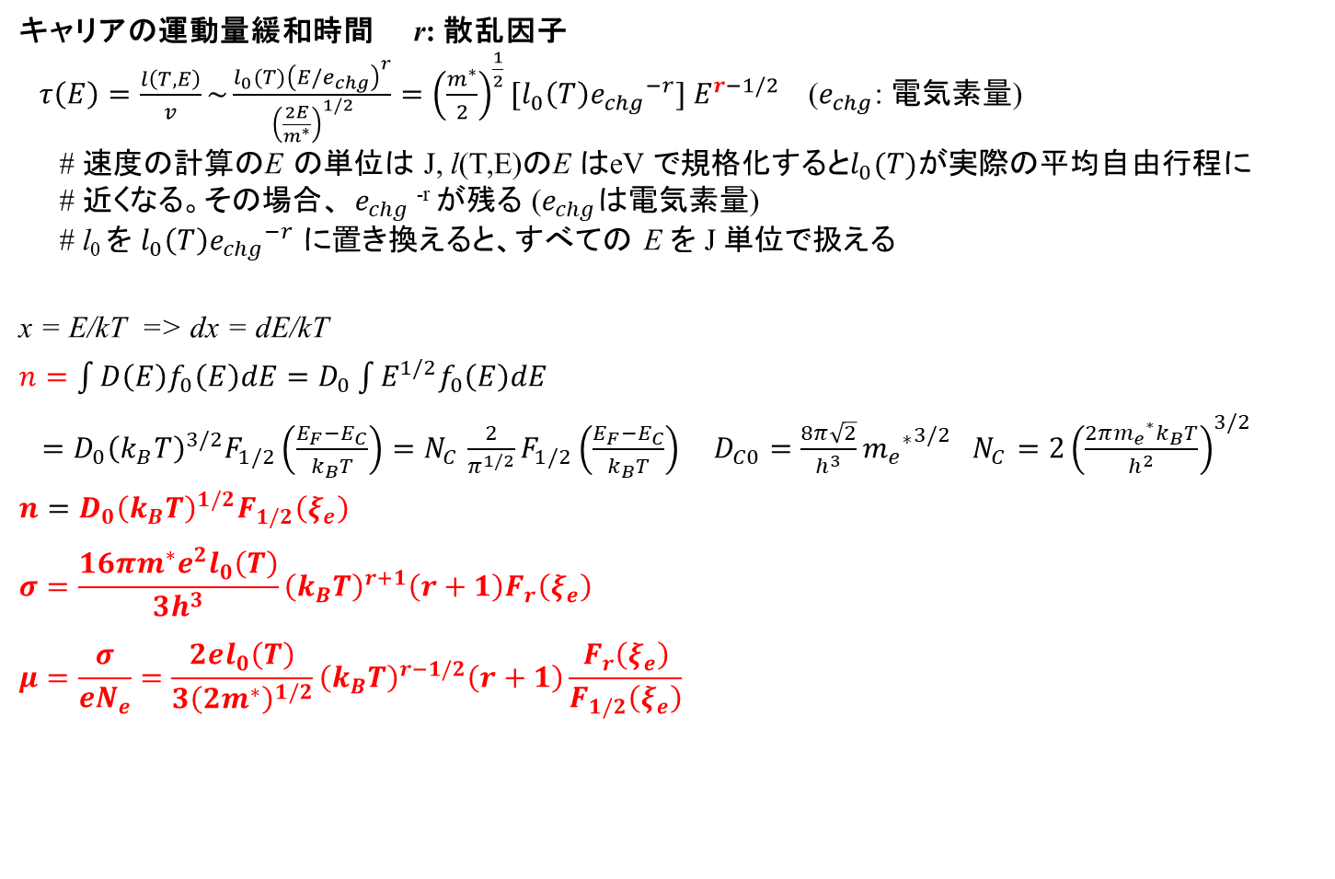
公式: 電気伝導度、移動度
  キャリアの運動量緩和時間 r: 散乱因子
  $τ\left(E\right)=\frac{l\left(T,E\right)}{v}\sim \frac{l_{0}(T){\left(E/e_{chg}\right)}^{r}}{{\left(\frac{2E}{m^{∗}}\right)}^{1/2}}={\left(\frac{m^{∗}}{2}\right)}^{\frac{1}{2}}[l_{0}\left(T\right){e_{chg}}^{−r}] E^{r−1/2}$ ($e_{chg}$: 電気素量)
  # 速度の計算のE の単位は J, l(T,E)のE はeV で規格化すると$l_{0}(T)$が実際の平均自由行程に
  # 近くなる。その場合、 $e_{chg}$^{-r} が残る ($e_{chg}$は電気素量)
  # l₀ を $l_{0}\left(T\right){e_{chg}}^{−r}$ に置き換えると、すべての E を J 単位で扱える
x = E/kT => dx = dE/kT
$n=\int{D\left(E\right)f_{0}\left(E\right)dE}=D_{0}\int{E^{1/2}f_{0}\left(E\right)dE}$
$=D_{0}{\left(k_{B}T\right)}^{3/2}F_{1/2}\left(\frac{E_{F}−E_{C}}{k_{B}T}\right){=N}_{C}\frac{2}{π^{1/2}}F_{1/2}\left(\frac{E_{F}−E_{C}}{k_{B}T}\right)$ $D_{C0}=\frac{8π\sqrt{2}}{h^{3}}{{m_{e}}^{∗}}^{3/2}$ $N_{C}=2{\left(\frac{{2πm_{e}}^{∗}k_{B}T}{h^{2}}\right)}^{3/2}$
$n=D_{0}{\left(k_{B}T\right)}^{1/2}F_{1/2}\left(ξ_{e}\right)$
$$σ=\frac{16πm^{∗}e^{2}l_{0}\left(T\right)}{3h^{3}}{\left(k_{B}T\right)}^{r+1}\left(r+1\right)F_{r}\left(ξ_{e}\right)$$
$$μ=\frac{σ}{eN_{e}}=\frac{2el_{0}\left(T\right)}{3{\left(2m^{∗}\right)}^{1/2}}{\left(k_{B}T\right)}^{r−1/2}\left(r+1\right)\frac{F_{r}\left(ξ_{e}\right)}{F_{1/2}\left(ξ_{e}\right)}$$

Slide 20
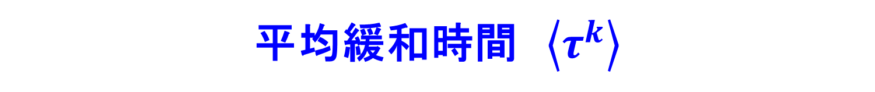
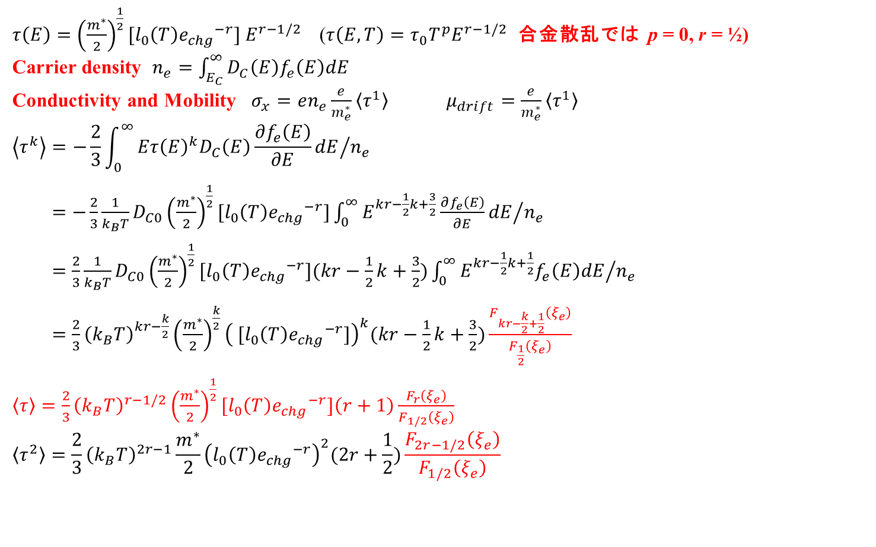
平均緩和時間 $\left\langle τ^{k}\right\rangle$
$τ\left(E\right)={\left(\frac{m^{∗}}{2}\right)}^{\frac{1}{2}}[l_{0}\left(T\right){e_{chg}}^{−r}] E^{r−1/2}$ ($τ\left(E,T\right)=τ_{0}T^{p}E^{r−1/2}$ 合金散乱では p = 0, r = ½)
Carrier density $n_{e}=\int_{E_{C}}^{∞}{D_{C}\left(E\right)f_{e}\left(E\right)dE}$
Conductivity and Mobility $σ_{x}=en_{e}\frac{e}{m_{e}^{∗}}\left\langle τ^{1}\right\rangle$ $μ_{drift}=\frac{e}{m_{e}^{∗}}\left\langle τ^{1}\right\rangle$
$$\left\langle τ^{k}\right\rangle =−\frac{2}{3}{\int_{0}^{∞}{Eτ{\left(E\right)}^{k}D_{C}\left(E\right)\frac{∂f_{e}\left(E\right)}{∂E}dE}}/{n_{e}}$$
$=−\frac{2}{3}\frac{1}{k_{B}T}D_{C0}{\left(\frac{m^{∗}}{2}\right)}^{\frac{1}{2}}[l_{0}\left(T\right){e_{chg}}^{−r}]{\int_{0}^{∞}{E^{kr−\frac{1}{2}k+\frac{3}{2}}\frac{∂f_{e}\left(E\right)}{∂E}dE}}/{n_{e}}$
$=\frac{2}{3}\frac{1}{k_{B}T}D_{C0}{\left(\frac{m^{∗}}{2}\right)}^{\frac{1}{2}}[l_{0}\left(T\right){e_{chg}}^{−r}](kr−\frac{1}{2}k+\frac{3}{2}){\int_{0}^{∞}{E^{kr−\frac{1}{2}k+\frac{1}{2}}f_{e}\left(E\right)dE}}/{n_{e}}$
$=\frac{2}{3}{\left(k_{B}T\right)}^{kr−\frac{k}{2}}{\left(\frac{m^{∗}}{2}\right)}^{\frac{k}{2}}{\left( [l_{0}\left(T\right){e_{chg}}^{−r}]\right)}^{k}(kr−\frac{1}{2}k+\frac{3}{2})\frac{F_{kr−\frac{k}{2}+\frac{1}{2}}\left(ξ_{e}\right)}{F_{\frac{1}{2}}\left(ξ_{e}\right)}$
$\left\langle τ\right\rangle =\frac{2}{3}{\left(k_{B}T\right)}^{r−1/2}{\left(\frac{m^{∗}}{2}\right)}^{\frac{1}{2}}[l_{0}\left(T\right){e_{chg}}^{−r}]\left(r+1\right)\frac{F_{r}\left(ξ_{e}\right)}{F_{1/2}\left(ξ_{e}\right)}$
$$\left\langle τ^{2}\right\rangle =\frac{2}{3}{\left(k_{B}T\right)}^{2r−1}\frac{m^{∗}}{2}{\left(l_{0}\left(T\right){e_{chg}}^{−r}\right)}^{2}(2r+\frac{1}{2})\frac{F_{2r−1/2}\left(ξ_{e}\right)}{F_{1/2}\left(ξ_{e}\right)}$$

Slide 21
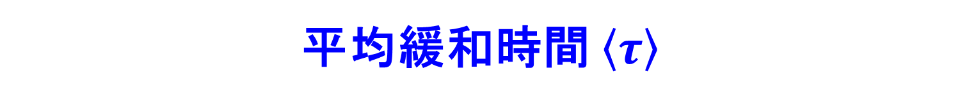
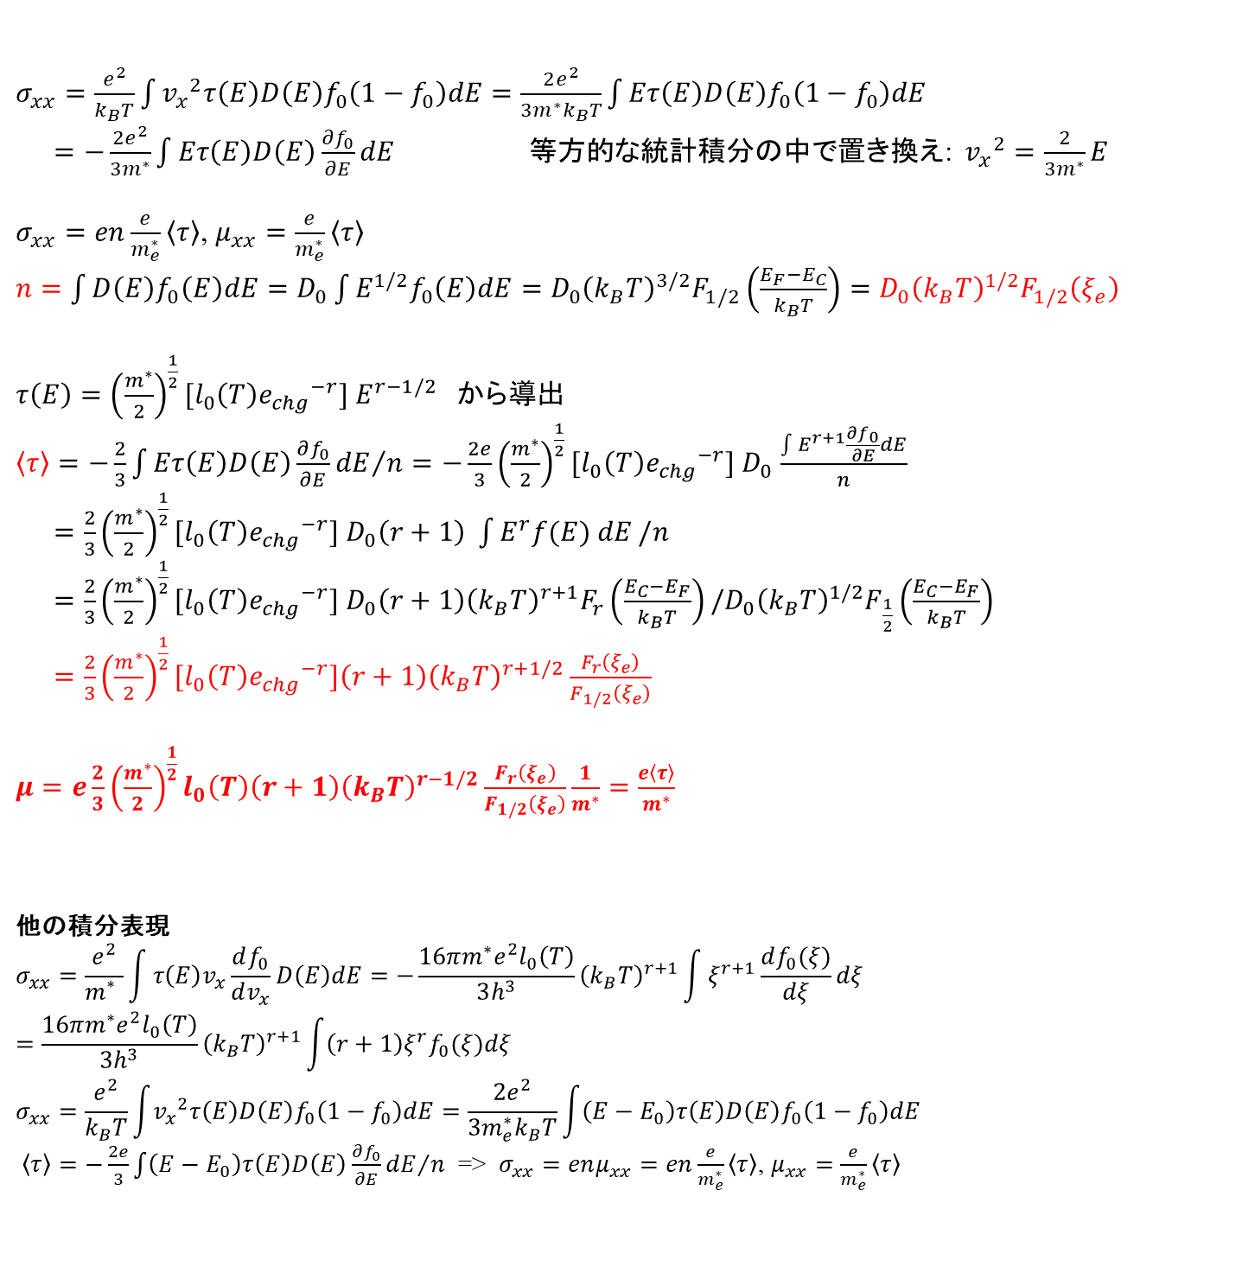
平均緩和時間 $\left\langle τ\right\rangle$
$σ_{xx}=\frac{e^{2}}{k_{B}T}\int{{v_{x}}^{2}τ\left(E\right)D\left(E\right)f_{0}\left(1−f_{0}\right)dE}=\frac{2e^{2}}{3m^{∗}k_{B}T}\int{Eτ\left(E\right)D\left(E\right)f_{0}\left(1−f_{0}\right)dE}$
$=−\frac{2e^{2}}{3m^{∗}}\int{Eτ\left(E\right)D\left(E\right)\frac{∂f_{0}}{∂E}dE}$ 等方的な統計積分の中で置き換え: ${v_{x}}^{2}=\frac{2}{3m^{∗}}E$
$σ_{xx}=en\frac{e}{m_{e}^{∗}}\left\langle τ\right\rangle$, $μ_{xx}=\frac{e}{m_{e}^{∗}}\left\langle τ\right\rangle$
$n=\int{D\left(E\right)f_{0}\left(E\right)dE}=D_{0}\int{E^{1/2}f_{0}\left(E\right)dE}=D_{0}{\left(k_{B}T\right)}^{3/2}F_{1/2}\left(\frac{E_{F}−E_{C}}{k_{B}T}\right)=D_{0}{\left(k_{B}T\right)}^{1/2}F_{1/2}\left(ξ_{e}\right)$
$τ\left(E\right)={\left(\frac{m^{∗}}{2}\right)}^{\frac{1}{2}}[l_{0}\left(T\right){e_{chg}}^{−r}] E^{r−1/2}$ から導出
$\left\langle τ\right\rangle ={−\frac{2}{3}\int{Eτ\left(E\right)D\left(E\right)\frac{∂f_{0}}{∂E}dE}}/n=−\frac{2e}{3}{\left(\frac{m^{∗}}{2}\right)}^{\frac{1}{2}}[l_{0}\left(T\right){e_{chg}}^{−r}] D_{0}$ $\frac{\int{E^{r+1}\frac{∂f_{0}}{∂E}dE}}{n}$
$=\frac{2}{3}{\left(\frac{m^{∗}}{2}\right)}^{\frac{1}{2}}[l_{0}\left(T\right){e_{chg}}^{−r}] D_{0}\left(r+1\right) \int{E^{r}f(E) dE}/n$
$=\frac{2}{3}{\left(\frac{m^{∗}}{2}\right)}^{\frac{1}{2}}[l_{0}\left(T\right){e_{chg}}^{−r}] D_{0}\left(r+1\right){\left(k_{B}T\right)}^{r+1}F_{r}\left(\frac{E_{C}−E_{F}}{k_{B}T}\right)/D_{0}{\left(k_{B}T\right)}^{1/2}F_{\frac{1}{2}}\left(\frac{E_{C}−E_{F}}{k_{B}T}\right)$
$=\frac{2}{3}{\left(\frac{m^{∗}}{2}\right)}^{\frac{1}{2}}[l_{0}\left(T\right){e_{chg}}^{−r}]\left(r+1\right){\left(k_{B}T\right)}^{r+1/2}\frac{F_{r}\left(ξ_{e}\right)}{F_{1/2}\left(ξ_{e}\right)}$
$μ=e\frac{2}{3}{\left(\frac{m^{∗}}{2}\right)}^{\frac{1}{2}}l_{0}\left(T\right)\left(r+1\right){\left(k_{B}T\right)}^{r−1/2}\frac{F_{r}\left(ξ_{e}\right)}{F_{1/2}\left(ξ_{e}\right)}\frac{1}{m^{∗}}=\frac{e\left\langle τ\right\rangle }{m^{∗}}$
他の積分表現
$$σ_{xx}=\frac{e^{2}}{m_{}^{∗}}\int{τ\left(E\right)v_{x}\frac{df_{0}}{dv_{x}}D\left(E\right)dE}=−\frac{16πm^{∗}e^{2}l_{0}\left(T\right)}{3h^{3}}{\left(k_{B}T\right)}^{r+1}\int{ξ^{r+1}\frac{df_{0}(ξ)}{dξ}dξ}=\frac{16πm^{∗}e^{2}l_{0}\left(T\right)}{3h^{3}}{\left(k_{B}T\right)}^{r+1}\int{\left(r+1\right)ξ^{r}f_{0}(ξ)dξ}$$
$$σ_{xx}=\frac{e^{2}}{k_{B}T}\int{{v_{x}}^{2}τ\left(E\right)D\left(E\right)f_{0}\left(1−f_{0}\right)dE}=\frac{2e^{2}}{3m_{e}^{∗}k_{B}T}\int{\left(E−E_{0}\right)τ\left(E\right)D\left(E\right)f_{0}\left(1−f_{0}\right)dE}$$
$\left\langle τ\right\rangle ={−\frac{2e}{3}\int{\left(E−E_{0}\right)τ\left(E\right)D\left(E\right)\frac{∂f_{0}}{∂E}dE}}/n$ => $σ_{xx}=enμ_{xx}=en\frac{e}{m_{e}^{∗}}\left\langle τ\right\rangle$, $μ_{xx}=\frac{e}{m_{e}^{∗}}\left\langle τ\right\rangle$

Slide 22
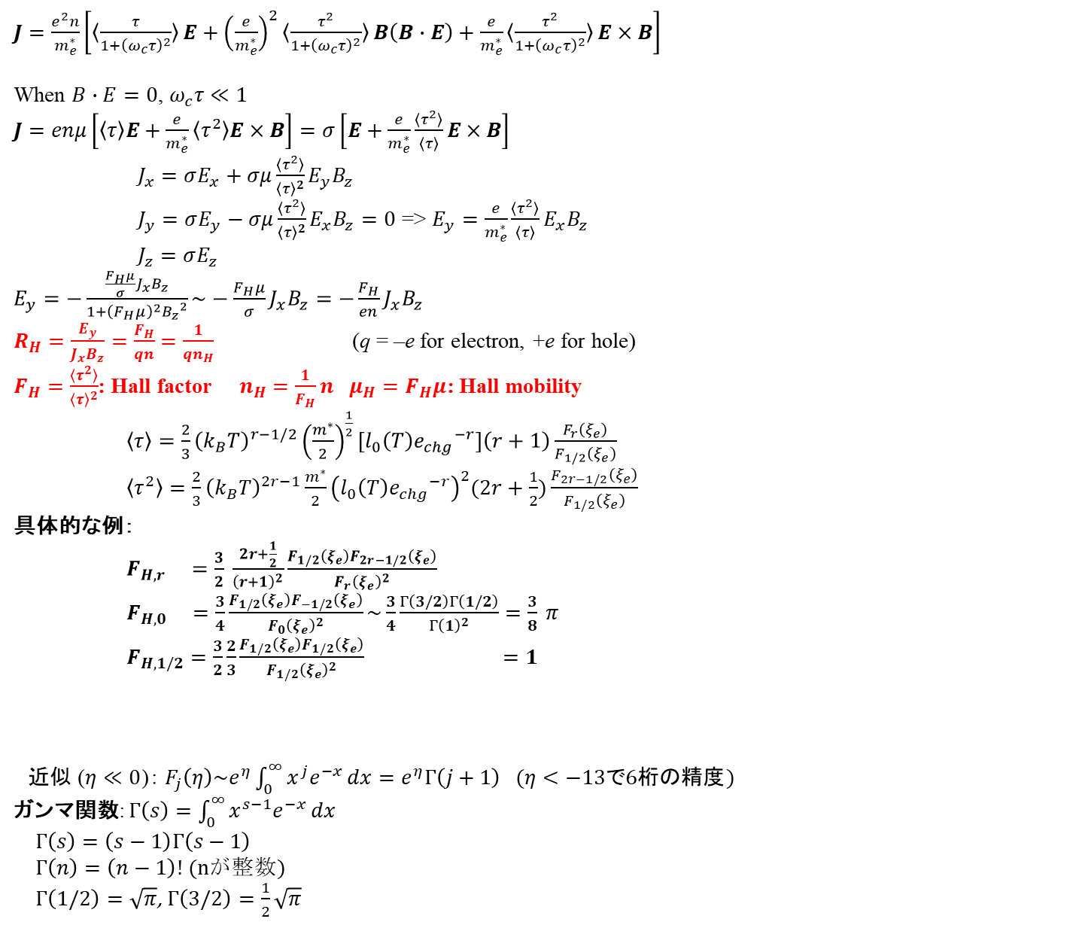
Hall effect
太田英二、坂田亮著、半導体の電子物性光学、培風館 (2005)
$J=\frac{e^{2}n}{m_{e}^{∗}}\left[〈\frac{τ}{1+{\left(ω_{c}τ\right)}^{2}}〉E+{\left(\frac{e}{m_{e}^{∗}}\right)}^{2}〈\frac{τ^{2}}{1+{\left(ω_{c}τ\right)}^{2}}〉B\left(B∙E\right)+\frac{e}{m_{e}^{∗}}〈\frac{τ^{2}}{1+{\left(ω_{c}τ\right)}^{2}}〉E×B\right]$
When $B∙E=0$, $ω_{c}τ≪1$
$J=enμ\left[〈τ〉E+\frac{e}{m_{e}^{∗}}〈τ^{2}〉E×B\right]=σ\left[E+\frac{e}{m_{e}^{∗}}\frac{〈τ^{2}〉}{〈τ〉}E×B\right]$
$J_{x}=σE_{x}+σμ\frac{〈τ^{2}〉}{{〈τ〉}^{2}}E_{y}B_{z}$
$J_{y}=σE_{y}−σμ\frac{〈τ^{2}〉}{{〈τ〉}^{2}}E_{x}B_{z}=0$ => $E_{y}=\frac{e}{m_{e}^{∗}}\frac{〈τ^{2}〉}{〈τ〉}E_{x}B_{z}$
$J_{z}=σE_{z}$
$E_{y}=−\frac{\frac{F_{H}μ}{σ}J_{x}B_{z}}{1+{\left(F_{H}μ\right)}^{2}{B_{z}}^{2}}\sim −\frac{F_{H}μ}{σ}J_{x}B_{z}=−\frac{F_{H}}{en}J_{x}B_{z}$
$R_{H}=\frac{E_{y}}{J_{x}B_{z}}=\frac{F_{H}}{qn}$ $=\frac{1}{qn_{H}}$ (q = –e for electron, +e for hole)
$F_{H}=\frac{〈τ^{2}〉}{{〈τ〉}^{2}}$: Hall factor $n_{H}$ $=\frac{1}{F_{H}}n$ $μ_{H}=F_{H}μ$: Hall mobility
$\left\langle τ\right\rangle =\frac{2}{3}{\left(k_{B}T\right)}^{r−1/2}{\left(\frac{m^{∗}}{2}\right)}^{\frac{1}{2}}[l_{0}\left(T\right){e_{chg}}^{−r}]\left(r+1\right)\frac{F_{r}\left(ξ_{e}\right)}{F_{1/2}\left(ξ_{e}\right)}$
$\left\langle τ^{2}\right\rangle =\frac{2}{3}{\left(k_{B}T\right)}^{2r−1}\frac{m^{∗}}{2}{\left(l_{0}\left(T\right){e_{chg}}^{−r}\right)}^{2}(2r+\frac{1}{2})\frac{F_{2r−1/2}\left(ξ_{e}\right)}{F_{1/2}\left(ξ_{e}\right)}$
具体的な例：
$F_{H,r} =\frac{3}{2} \frac{2r+\frac{1}{2}}{{\left(r+1\right)}^{2}}\frac{F_{1/2}\left(ξ_{e}\right)F_{2r−1/2}\left(ξ_{e}\right)}{{F_{r}\left(ξ_{e}\right)}^{2}}$
$F_{H,0} =\frac{3}{4}\frac{F_{1/2}\left(ξ_{e}\right)F_{−1/2}\left(ξ_{e}\right)}{{F_{0}\left(ξ_{e}\right)}^{2}}\sim \frac{3}{4}\frac{Γ\left(3/2\right)Γ\left(1/2\right)}{{Γ\left(1\right)}^{2}}=\frac{3}{8} π$
$F_{H,1/2}=\frac{3}{2}\frac{2}{3}\frac{F_{1/2}\left(ξ_{e}\right)F_{1/2}\left(ξ_{e}\right)}{{F_{1/2}\left(ξ_{e}\right)}^{2}} =1$
  近似 ($η≪0$)： $F_{j}\left(η\right)\sim e^{η}\int_{0}^{∞}{x^{j}e^{−x}}dx=e^{η}Γ\left(j+1\right) (η<−13で6桁の精度)$
  ガンマ関数: $Γ\left(s\right)=\int_{0}^{∞}{x^{s−1}e^{−x}}dx$
  $Γ\left(s\right)=\left(s−1\right)Γ\left(s−1\right)$
  $Γ\left(n\right)=\left(n−1\right)!$ (nが整数)
  $Γ\left(1/2\right)=\sqrt{π}$, $Γ\left(3/2\right)=\frac{1}{2}\sqrt{π}$

Slide 23
Hall因子 F_{Hall}
R_{H} = F_{Hall} / en
F_{Hall}: 散乱機構に依存
N_{C} = 5.3×10¹⁸ cm⁻³

Slide 24
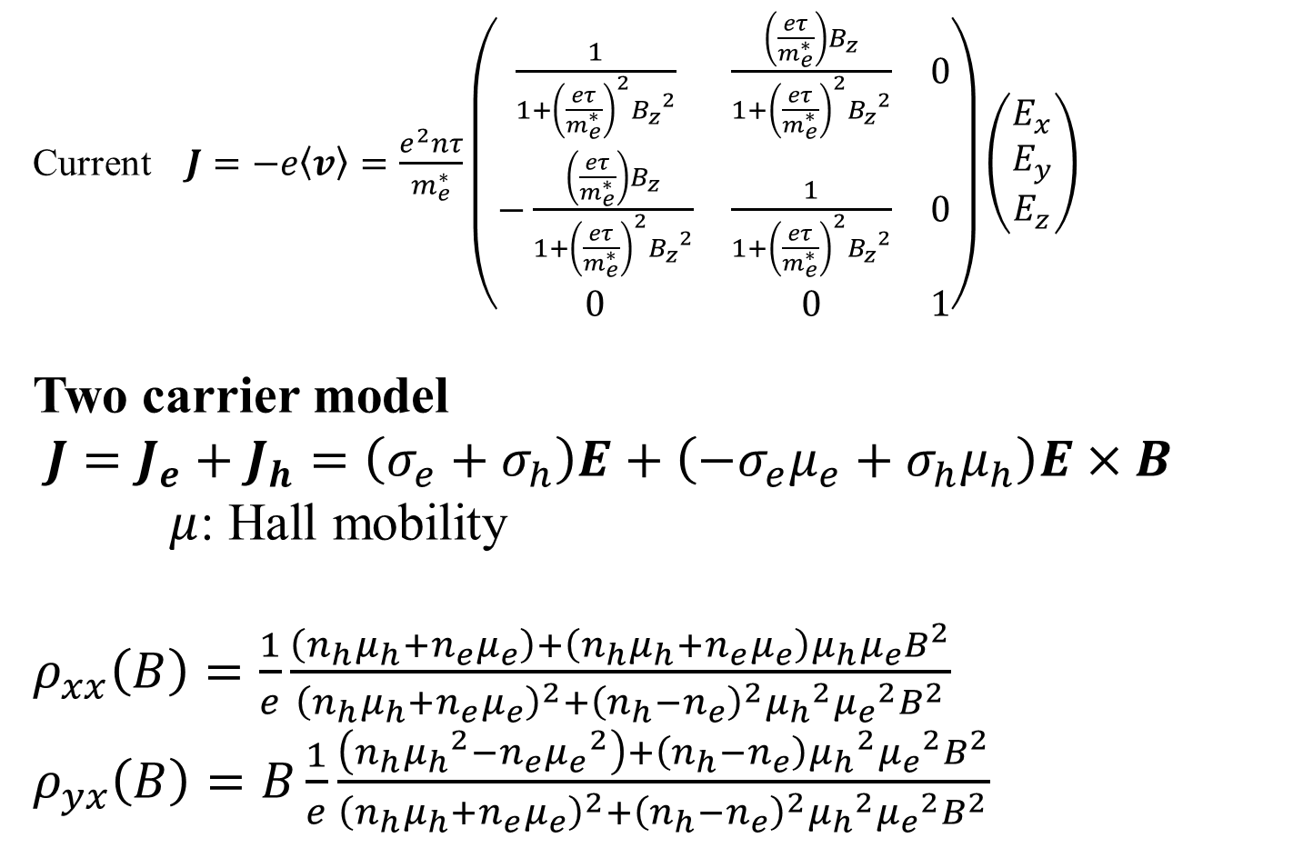
Hall effect: Two-carrier model
太田英二、坂田亮著、半導体の電子物性工学、培風館 (2005)
Current $J=−e〈v〉=\frac{e^{2}nτ}{m_{e}^{∗}}\left(\begin{matrix}\frac{1}{1+{\left(\frac{eτ}{m_{e}^{∗}}\right)}^{2}{B_{z}}^{2}} & \frac{\left(\frac{eτ}{m_{e}^{∗}}\right)B_{z}}{1+{\left(\frac{eτ}{m_{e}^{∗}}\right)}^{2}{B_{z}}^{2}} & 0 \\ −\frac{\left(\frac{eτ}{m_{e}^{∗}}\right)B_{z}}{1+{\left(\frac{eτ}{m_{e}^{∗}}\right)}^{2}{B_{z}}^{2}} & \frac{1}{1+{\left(\frac{eτ}{m_{e}^{∗}}\right)}^{2}{B_{z}}^{2}} & 0 \\ 0 & 0 & 1\end{matrix}\right)\left(\begin{matrix}E_{x} \\ E_{y} \\ E_{z}\end{matrix}\right)$
Two carrier model
$J=J_{e}+J_{h}=\left(σ_{e}+σ_{h}\right)E+\left(−σ_{e}μ_{e}+σ_{h}μ_{h}\right)E×B$
$μ$: Hall mobility
$ρ_{xx}\left(B\right)=\frac{1}{e}\frac{\left(n_{h}μ_{h}+n_{e}μ_{e}\right)+\left(n_{h}μ_{h}+n_{e}μ_{e}\right)μ_{h}μ_{e}B^{2}}{{\left(n_{h}μ_{h}+n_{e}μ_{e}\right)}^{2}+{\left(n_{h}−n_{e}\right)}^{2}{μ_{h}}^{2}{μ_{e}}^{2}B^{2}}$
$ρ_{yx}\left(B\right)=B\frac{1}{e}\frac{\left(n_{h}{μ_{h}}^{2}−n_{e}{μ_{e}}^{2}\right)+\left(n_{h}−n_{e}\right){μ_{h}}^{2}{μ_{e}}^{2}B^{2}}{{\left(n_{h}μ_{h}+n_{e}μ_{e}\right)}^{2}+{\left(n_{h}−n_{e}\right)}^{2}{μ_{h}}^{2}{μ_{e}}^{2}B^{2}}$

Slide 25
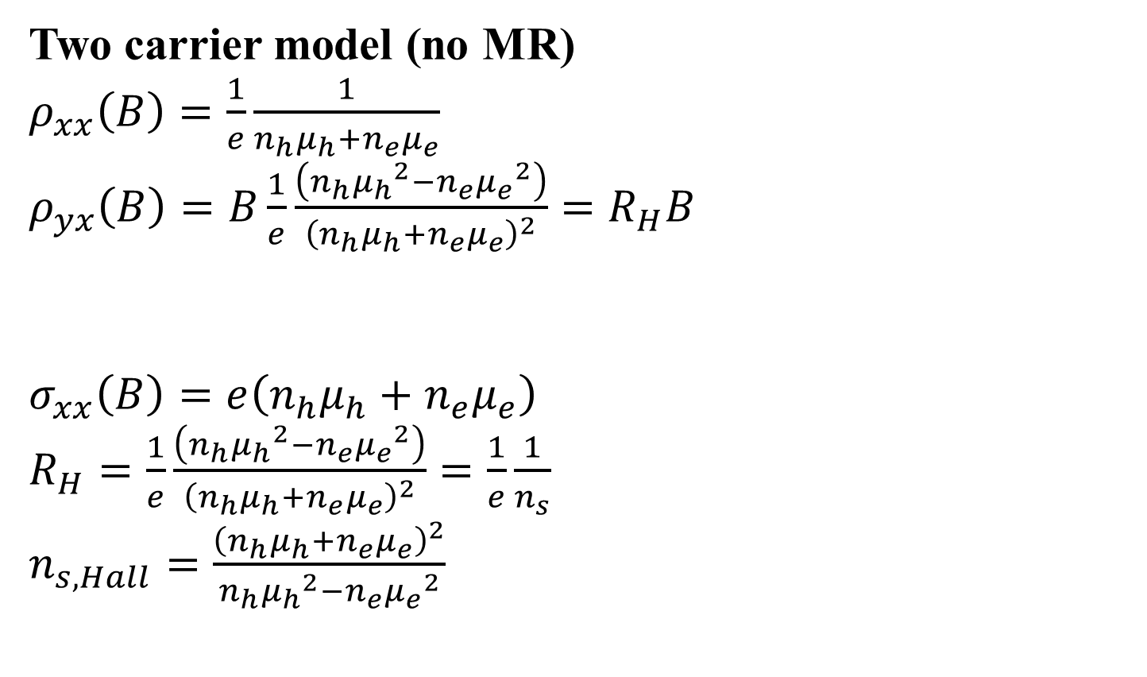
Hall effect: Two-carrier model w/o MR
太田英二、坂田亮著、半導体の電子物性工学、培風館 (2005)
Two carrier model (no MR)
$ρ_{xx}\left(B\right)=\frac{1}{e}\frac{1}{n_{h}μ_{h}+n_{e}μ_{e}}$
$ρ_{yx}\left(B\right)=B\frac{1}{e}\frac{\left(n_{h}{μ_{h}}^{2}−n_{e}{μ_{e}}^{2}\right)}{{\left(n_{h}μ_{h}+n_{e}μ_{e}\right)}^{2}}=R_{H}B$
$σ_{xx}\left(B\right)=e\left(n_{h}μ_{h}+n_{e}μ_{e}\right)$
$R_{H}=\frac{1}{e}\frac{\left(n_{h}{μ_{h}}^{2}−n_{e}{μ_{e}}^{2}\right)}{{\left(n_{h}μ_{h}+n_{e}μ_{e}\right)}^{2}}=\frac{1}{e}\frac{1}{n_{s}}$
$n_{s,Hall}=\frac{{\left(n_{h}μ_{h}+n_{e}μ_{e}\right)}^{2}}{n_{h}{μ_{h}}^{2}−n_{e}{μ_{e}}^{2}}$

Slide 26
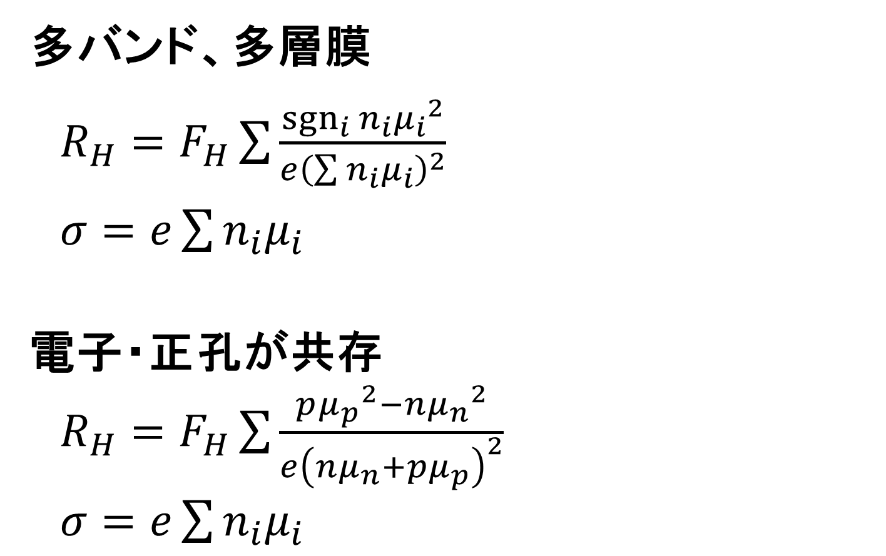
多バンド、狭いバンドギャップのHall係数
多バンド、多層膜
$R_{H}=F_{H}\sum{\frac{{sgn}_{i}{n_{i}}{μ_{i}}^{2}}{e{\left(\sum{n_{i}μ_{i}}\right)}^{2}}}$
$σ=e\sum{n_{i}μ_{i}}$
電子・正孔が共存
$R_{H}=F_{H}\sum{\frac{p{μ_{p}}^{2}−n{μ_{n}}^{2}}{e{\left(nμ_{n}+pμ_{p}\right)}^{2}}}$
$σ=e\sum{n_{i}μ_{i}}$

Slide 27
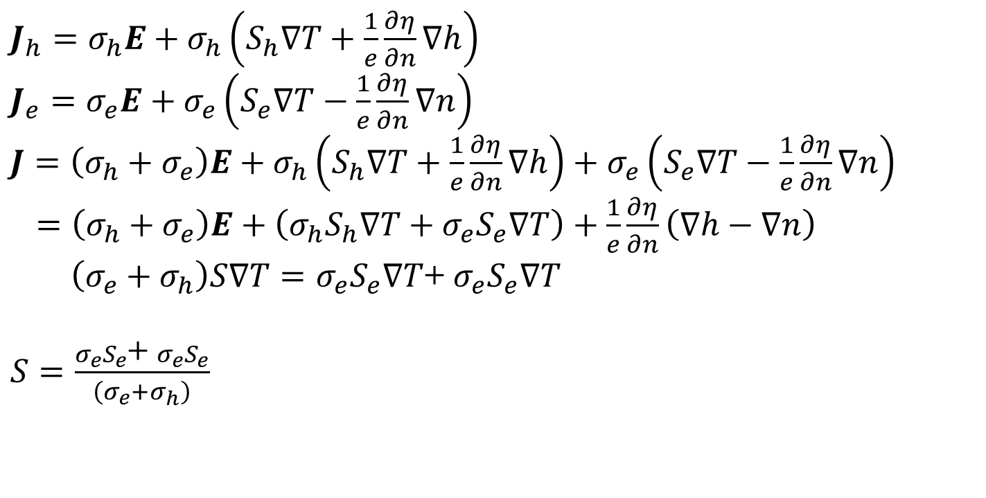
Seebeck effect
太田英二、坂田亮著、半導体の電子物性工学、培風館 (2005)
T.C. Chasapis, et al., APL Mater. 3, 083601 (2015)
S.A.Miller, et al, Phys. Rev. Appl. 9, 014025 (2018)
$J_{h}=σ_{h}E+σ_{h}\left(S_{h}∇T+\frac{1}{e}\frac{∂η}{∂n}∇h\right)$
$J_{e}=σ_{e}E+σ_{e}\left(S_{e}∇T−\frac{1}{e}\frac{∂η}{∂n}∇n\right)$
$J=\left(σ_{h}+σ_{e}\right)E+σ_{h}\left(S_{h}∇T+\frac{1}{e}\frac{∂η}{∂n}∇h\right)+σ_{e}\left(S_{e}∇T−\frac{1}{e}\frac{∂η}{∂n}∇n\right)$
$=\left(σ_{h}+σ_{e}\right)E+\left(σ_{h}S_{h}∇T+σ_{e}S_{e}∇T\right)+\frac{1}{e}\frac{∂η}{∂n}\left(∇h−∇n\right)$
$\left(σ_{e}+σ_{h}\right)S∇T=σ_{e}S_{e}∇T$+ $σ_{e}S_{e}∇T$
$S=\frac{σ_{e}S_{e}\text{+} σ_{e}S_{e}}{\left(σ_{e}+σ_{h}\right)}$

