Slide 1
Editor vs Word processor
 | Editor | Word processor
Startup time (起動時間) | Shorter | Longer
Processing speed (実行速度) | Faster | Slower
Memory | Light | Heavy
Text style / format | Usually none | Required
File format | Basically text-based | Application specific
Others | Specialized for specific program languages. Macro (small program languages) | Print (WYSIWYG): What You See is What You Get
Examples | Linux : vi, emax Windows: TeraPad, Sakura Edtior Multi : Visual Studio Code, Sublime text, Atom | MS-Word
Recommendation:
Microsoft Visual Studio Code: https://code.visualstudio.com/
Multiplatform (Windows, MacOS, Linux)
Multilanguage
Integrated Development Editor (IDE)

Slide 2
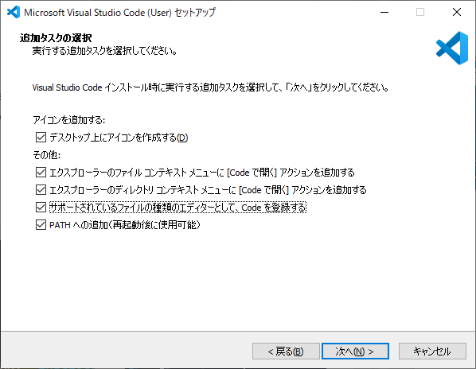
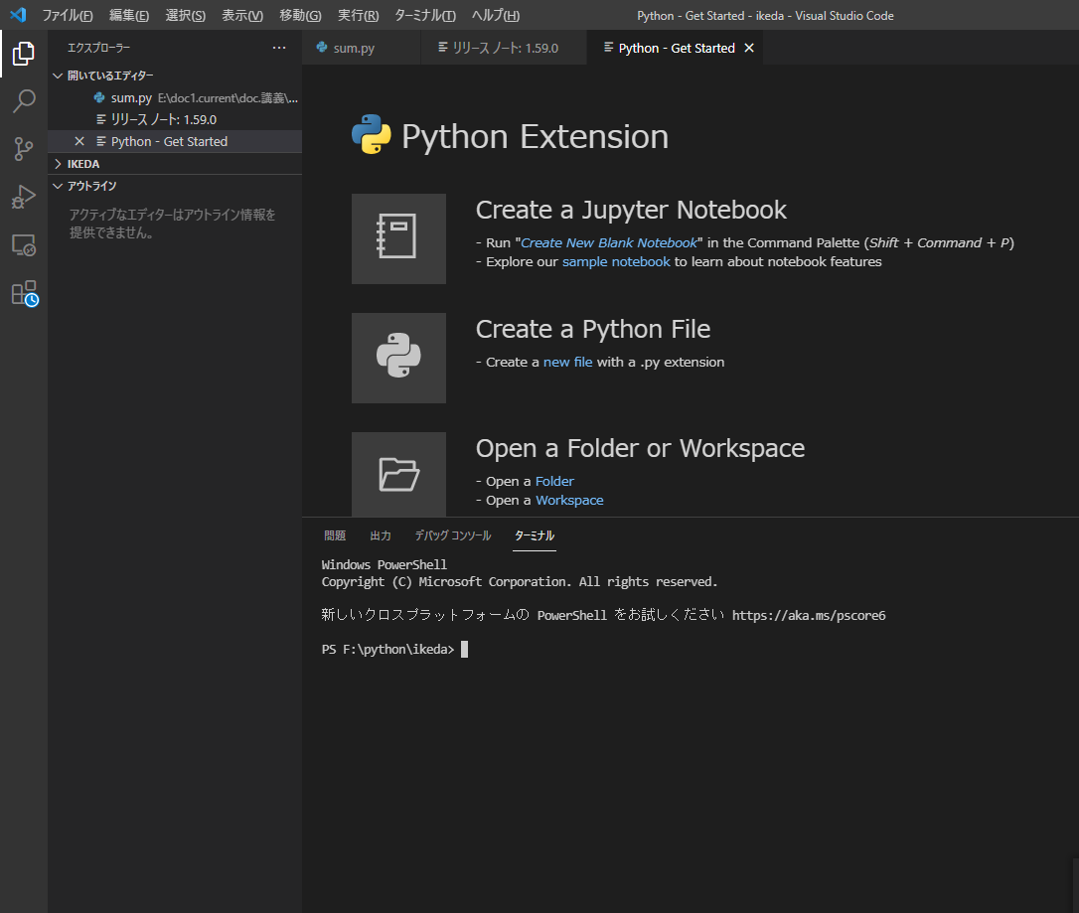
Visual Code Studioのインストール
Download from https://code.visualstudio.com/
Run installer

Slide 3
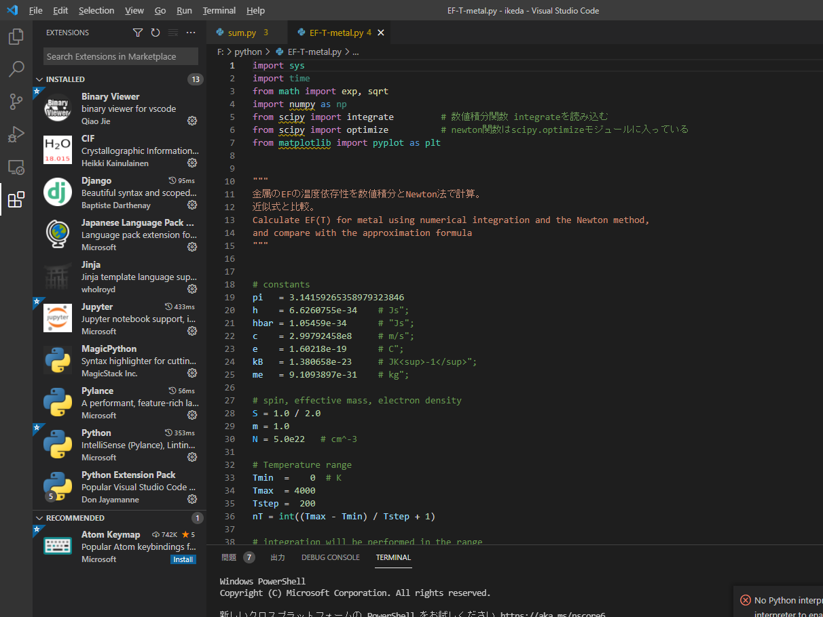
python 拡張機能
Visual Studio Code を使用して Python 初心者向けの開発環境をセットアップする
https://docs.microsoft.com/ja-jp/learn/modules/python-install-vscode/
2. Search ‘python’
3. Click ‘Install’
Read a python script. Keywords are marked by color
1. Click the bottom ion on the left pane

Slide 4
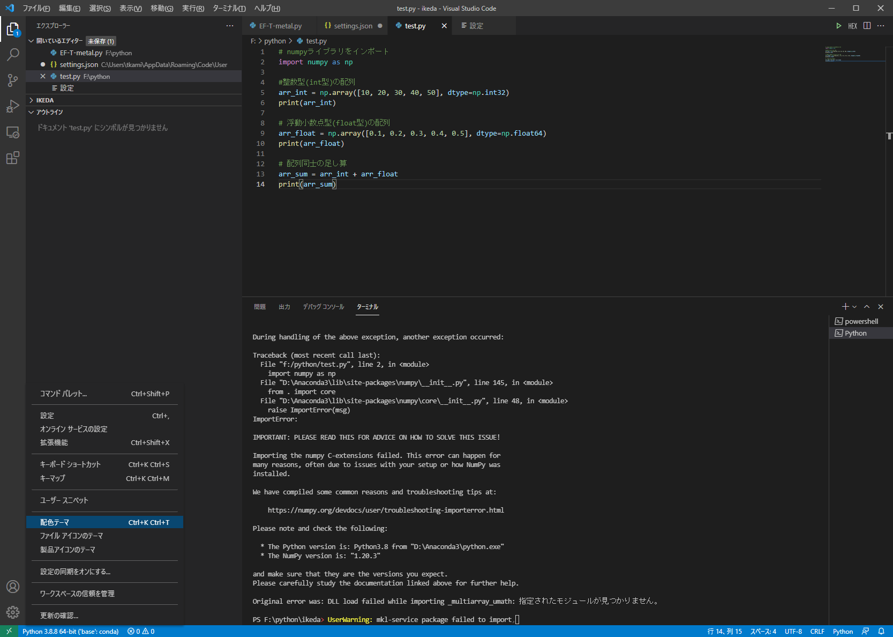
任意: 配色テーマ設定
3. Choose your favorite color theme
2. Choose ‘Color Theme’
1. Click Left-bottom icon

Slide 5
その他のおすすめ拡張機能
Material Icon Theme:
エクスプローラビューのアイコンを変えて見易くする
zenkaku: 全角スペースをハイライト

Slide 6
任意: ファイルの文字コードの自動判別
3. Input ‘Encoding’ in the Top Textbox and ENTER
4. Check here for auto guess encoding
2. Choose ‘Configure’
For Default installation:
python.pythonpath C:\Users\[User Name]\anaconda3\python.exe
python.condapath C:\Users\[User Name]\anaconda3\Scripts
python.defaultInterpreterPath C:\Users\[User Name]\anaconda3\python.exe
For your own environment [ENV]
python.pythonpath C:\Users\[User Name]\anaconda3\envs\[ENV]\python.exe
python.condapath C:\Users\[User Name]\anaconda3\Scripts
python.defaultInterpreterPath C:\Users\[User Name]\anaconda3\envs\[ENV]\python.exe
5. Change these if you want to change default encoding / end-of-line (Eol) code
1. Click left-bottom icon

Slide 7
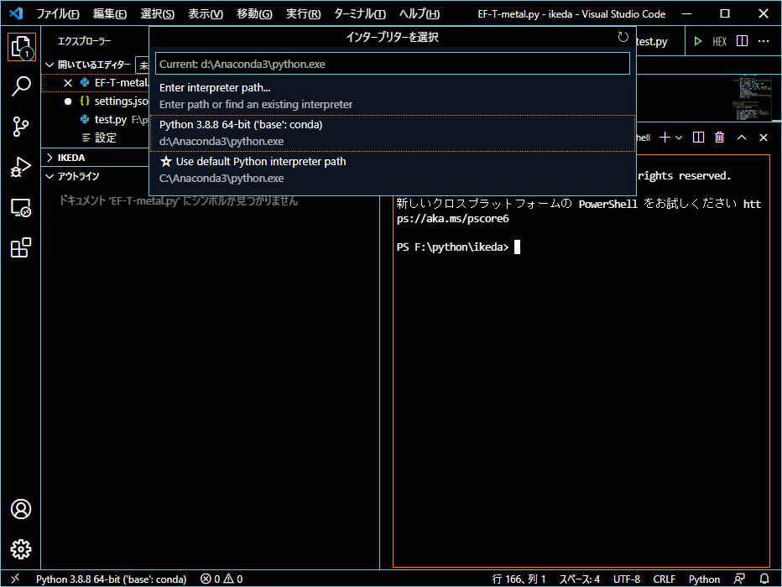
Python.exeの選択
2. Choose your python interpreter
‘Python 3.8.XXX (‘base’: conda’)
1. Click left ‘python’ in the bottom Status Bar

Slide 8
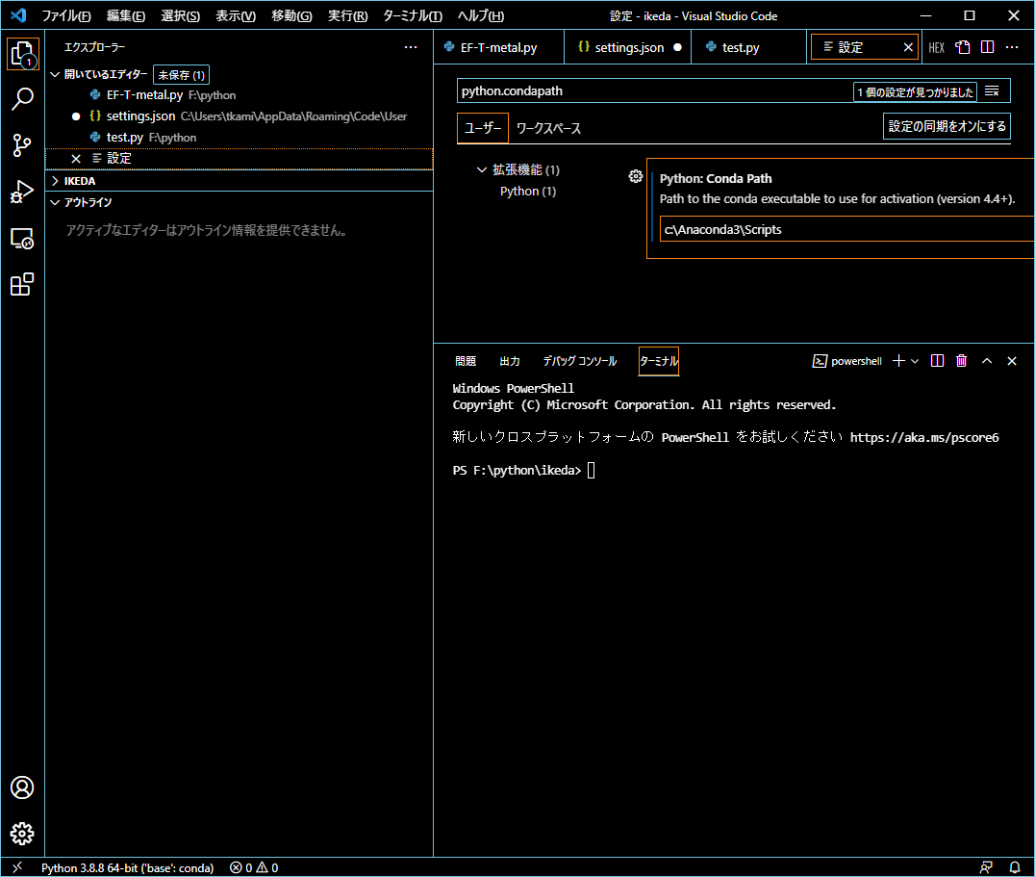
必要な場合のみ: VSC python.*path変数の設定
3. Input ‘python.pythonpath’ in the Top Textbox and ENTER
2. Choose ‘Configure’
4. Confirm your python.exe path or modify
5. Similarly input python.condapath, python.defaultInterpreterPath
For Default installation:
python.pythonpath C:\Users\[User Name]\anaconda3\python.exe
python.condapath C:\Users\[User Name]\anaconda3\Scripts
python.defaultInterpreterPath C:\Users\[User Name]\anaconda3\python.exe
For your own environment [ENV]
python.pythonpath C:\Users\[User Name]\anaconda3\envs\[ENV]\python.exe
python.condapath C:\Users\[User Name]\anaconda3\Scripts
python.defaultInterpreterPath C:\Users\[User Name]\anaconda3\envs\[ENV]\python.exe
1. Click left-bottom icon

Slide 9
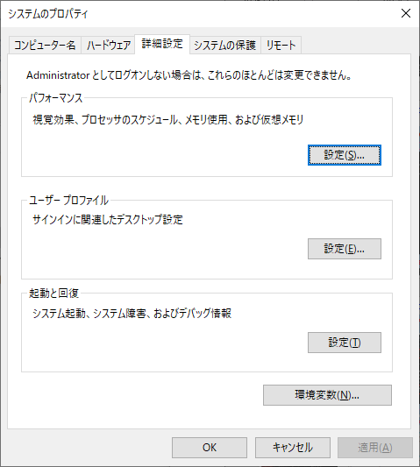
必要な場合のみ: PATH Variable
NOTE: VCS + Anaconda often fails load numpy mkl modules and DLLs Better to specify the Library and DLL paths to the PATH variable
Run Windows Explorer
1. Left click mouse button
3. Click ‘System configuration’
2. Choose ‘Property’
4. Click ‘Environment Variables’

Slide 10
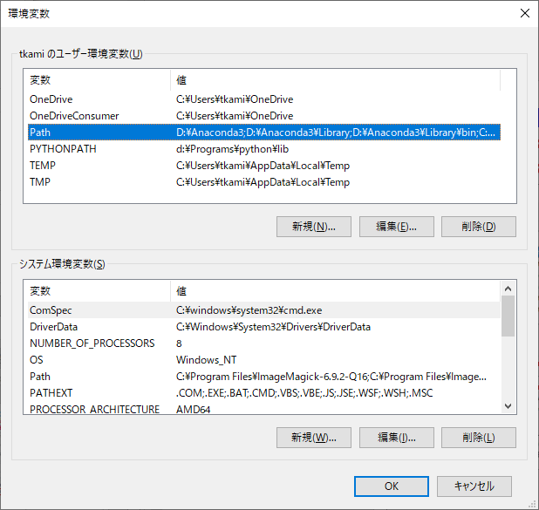
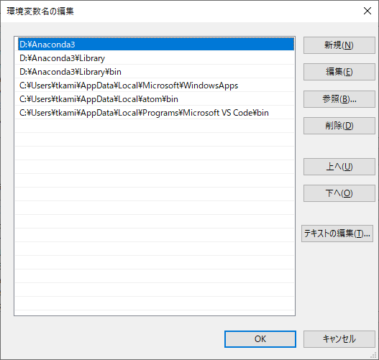
必要な場合のみ: PATH Variable
If you can’t run a python script using numpy from VSC:
6. Add
C:\Users\[User Name]\anaconda3
C:\Users\[User Name]\anaconda3\Library
C:\Users\[User Name]\anaconda3\Library\bin
or these three paths on your installation
5. Double click ‘Path’
7. Move them to top by ‘Up’ button on right

Slide 11
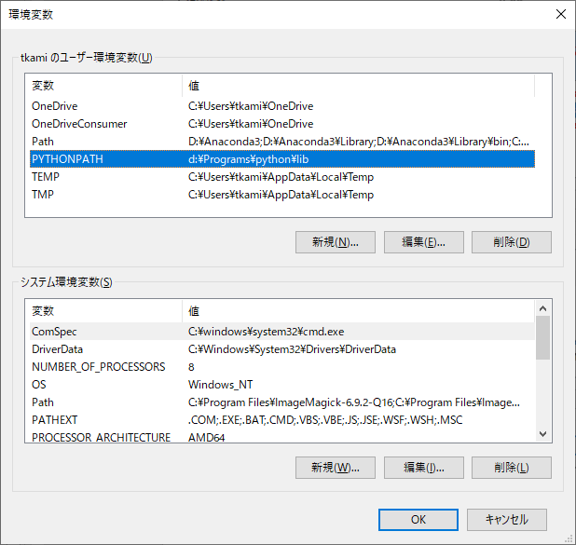
必要な場合のみ:その他のpython module
6. Add your library paths. Multiple paths are given with the separator ‘;’
E.g., d:\Programs\python\lib for T. Kamiya’s library
1. Double click ‘PYTHONPATH’

Slide 12
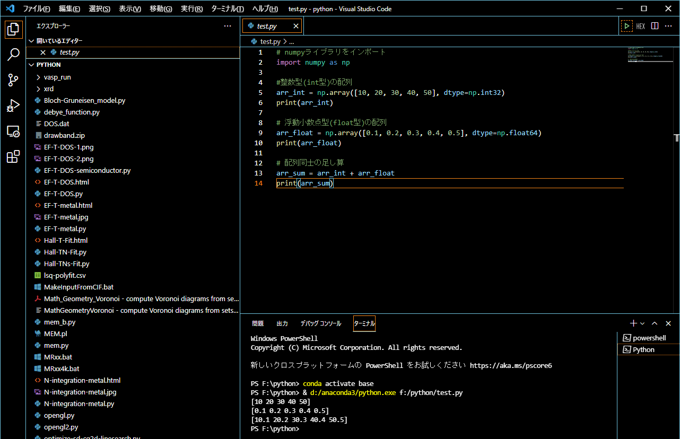
[必須] 動作確認: Visual Code Studio: 実行
1. Open python script or folder: “ファイル” => “フォルダーを開く” で [data-COE]を開く 2. test.py を開く
3. Click ‘▷’ to run
Suceeded

Slide 13
任意: デバッグ
VisualStudioCodeでPython環境構築 – Qiita
https://qiita.com/ryt-t5/items/4f15c5b069ad3e6910e8

Slide 14
任意: 便利な拡張機能: CSV
3. Read a CSV file and click ‘Edit csv’
2. Click ‘Install’
f
1. Click the bottom ion on the left pane

Slide 15
付録

Slide 16
環境変数の設定: 別の方法
環境変数を設定してから VSC (code.exe) を実行するバッチファイルを作る
注意: condaコマンドはバッチファイルなので、callコマンドで呼び出す必要がある
[ENV]はcondaの仮想環境名
vsc.bat: ここから
call conda activate [ENV]
code
vsc.bat: ここまで

Slide 17
関係する環境変数
_CONDA_EXE d:/anaconda3\Scripts\conda.exe
_CONDA_ROOT d:/anaconda3
CONDA_DEFAULT_ENV 2.7
CONDA_EXE D:\anaconda3\Scripts\conda.exe
CONDA_PREFIX D:\anaconda3\envs\2.7
CONDA_PREFIX_1 d:\anaconda3
CONDA_PROMPT_MODIFIER (2.7)
CONDA_PYTHON_EXE D:\anaconda3\python.exe
CONDA_SHLVL 2
PYTHONPATH d:\Programs\python\lib
PATH: 仮想環境
D:\anaconda3\envs\2.7;
D:\anaconda3\envs\2.7\Library\mingw-w64\bin;
D:\anaconda3\envs\2.7\Library\usr\bin;
D:\anaconda3\envs\2.7\Library\bin;
D:\anaconda3\envs\2.7\Scripts;
D:\anaconda3\envs\2.7\bin;
D:\anaconda3\condabin;
PATH: Base仮想環境
D:\anaconda3\condabin;
D:\Anaconda3;
d:\Anaconda3\Library;
D:\Anaconda3\Library\bin;

Slide 18
便利な拡張機能: Bin (バイナリエディタ)
3. Read a binary file and click ‘HEX’
1. Click the bottom ion on the left pane
f
2. Click ‘Install’

